Slide 1
Digital Portfolio
STUDENT NAME: CHANDIRASEKARAN C
REGISTER NO AND NMID: 35524U09005 &89EEDAAB5E4D79CA7F74204EF0380439
DEPARTMENT: BCA ll
COLLEGE: COLLEGE/ UNIVERSITY GOVERNMENT ARTS & SCIENCE COLLEGE TIRUPATTUR/ TIRUVALLUVAR UNIVERSITY

Slide 2
PROJECT TITLE
DIGITAL FORTOFINO

Slide 3


AGENDA
Problem Statement
Project Overview
End Users
Tools and Technologies
Portfolio design and Layout
Features and Functionality
Results and Screenshots
Conclusion
Github Link
3/21/2024 Annual Review

Slide 4

PROBLEM STATEMENT
To provide a solution, I need a specific problem statement. Please provide more details about the problem you're trying to solve, including:1. The context or topic2. The specific question or issue3. Any relevant constraints or requirementsWith a clear problem statement, I can assist you more effectively.

Slide 5

PROJECT OVERVIEW
To provide a comprehensive project overview, I'll need more information about the project. Please provide details such as: 1. Project title and objective 2. Scope and requirements 3. Target audience or stakeholders 4. Key features or components 5. Desired outcomes or deliverabl With this information, I can help you create a clear and concise project overview.

Slide 6

WHO ARE THE END USERS?
To provide a comprehensive project overview, I'll need more information about the project. Please provide details such as. 1. Project title and objective 2. Scope and requirements 3. Target audience or stakeholders 4. Key features or components 5. Desired outcomes or deliverables With this information, I can help you create a clear and concise project overview.

Slide 7

TOOLS AND TECHNIQUES
HTML Website Development Tools and Techniques1. *HTML*: Structuring content using semantic elements.2. *CSS*: Styling and layout using selectors, properties, and values.3. *JavaScript*: Adding interactivity and dynamic effects.4. *Code Editors*: VS Code, Sublime Text, Atom.5. *Frameworks*: Bootstrap, Foundation for responsive design.

Slide 8
POTFOLIO DESIGN AND LAYOUT
Portfolio Design and Layout1. *Clear Navigation*: Easy-to-use menu and sections.2. *Visual Hierarchy*: Organize content to highlight key projects.3. *Consistent Branding*: Use consistent colors, typography, and imagery.4. *Project Showcase*: Display projects with images, descriptions, and links.5. *Responsive Design*: Ensure a great user experience on all devices.
8

Slide 9
FEATURES AND FUNCTIONALITY
HTML Features and Functionality1. *Structuring Content*: HTML structures content using elements like headings, paragraphs, and lists.2. *Creating Hyperlinks*: HTML enables hyperlink creation using the `<a>` element.3. *Displaying Multimedia*: HTML displays multimedia content like images, videos, and audio.4. *Collecting User Input*: HTML forms collect user input using elements like `<input>` and `<textarea>`.5. *Semantic Meaning*: HTML5 semantic elements provide meaning to content, improving accessibility and SEO.

Slide 10
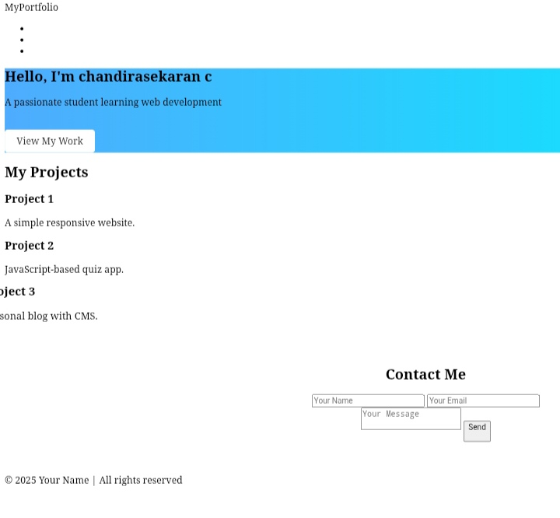

RESULTS AND SCREENSHOTS
3/21/2024 Annual Review
10

Slide 11
CONCLUSION
Conclusion In conclusion, HTML plays a vital role in building the structure and content of web pages. By leveraging its features and functionality, developers can create well-structured, accessible, and user-friendly websites that provide a great user experience. Effective use of HTML is essential for web development, and its importance cannot be overstated.
11

Slide 12
GitHub

